Slide 1
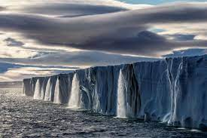
The Impact of Climate Change
Threat of mass destruction from rising sea levels

Slide 2
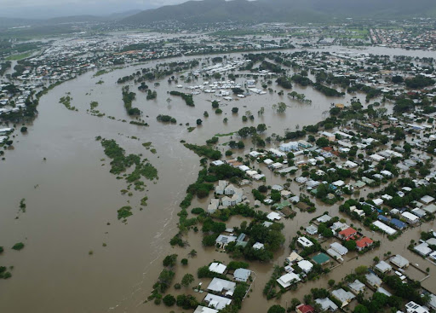
Rising Sea Levels
Insert graph of rising sea levels
Notes:
Sea levels are rising every year due to global warming. Without action there will be mass destruction of coastal cities due to flooding.

Slide 3
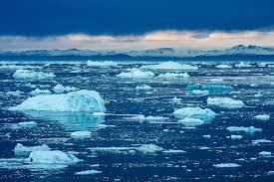
Diminishing Ice Levels
Insert sea ice chart
Notes:
The biggest contributor to rising sea levels in the diminishing polar ice caps. When the ice melts more water is introduced into the sea. This results in warming and expansion of sea water which in turn melts more ice. This cycle has caused ice to melt at an accelerated rate over time.

Slide 4
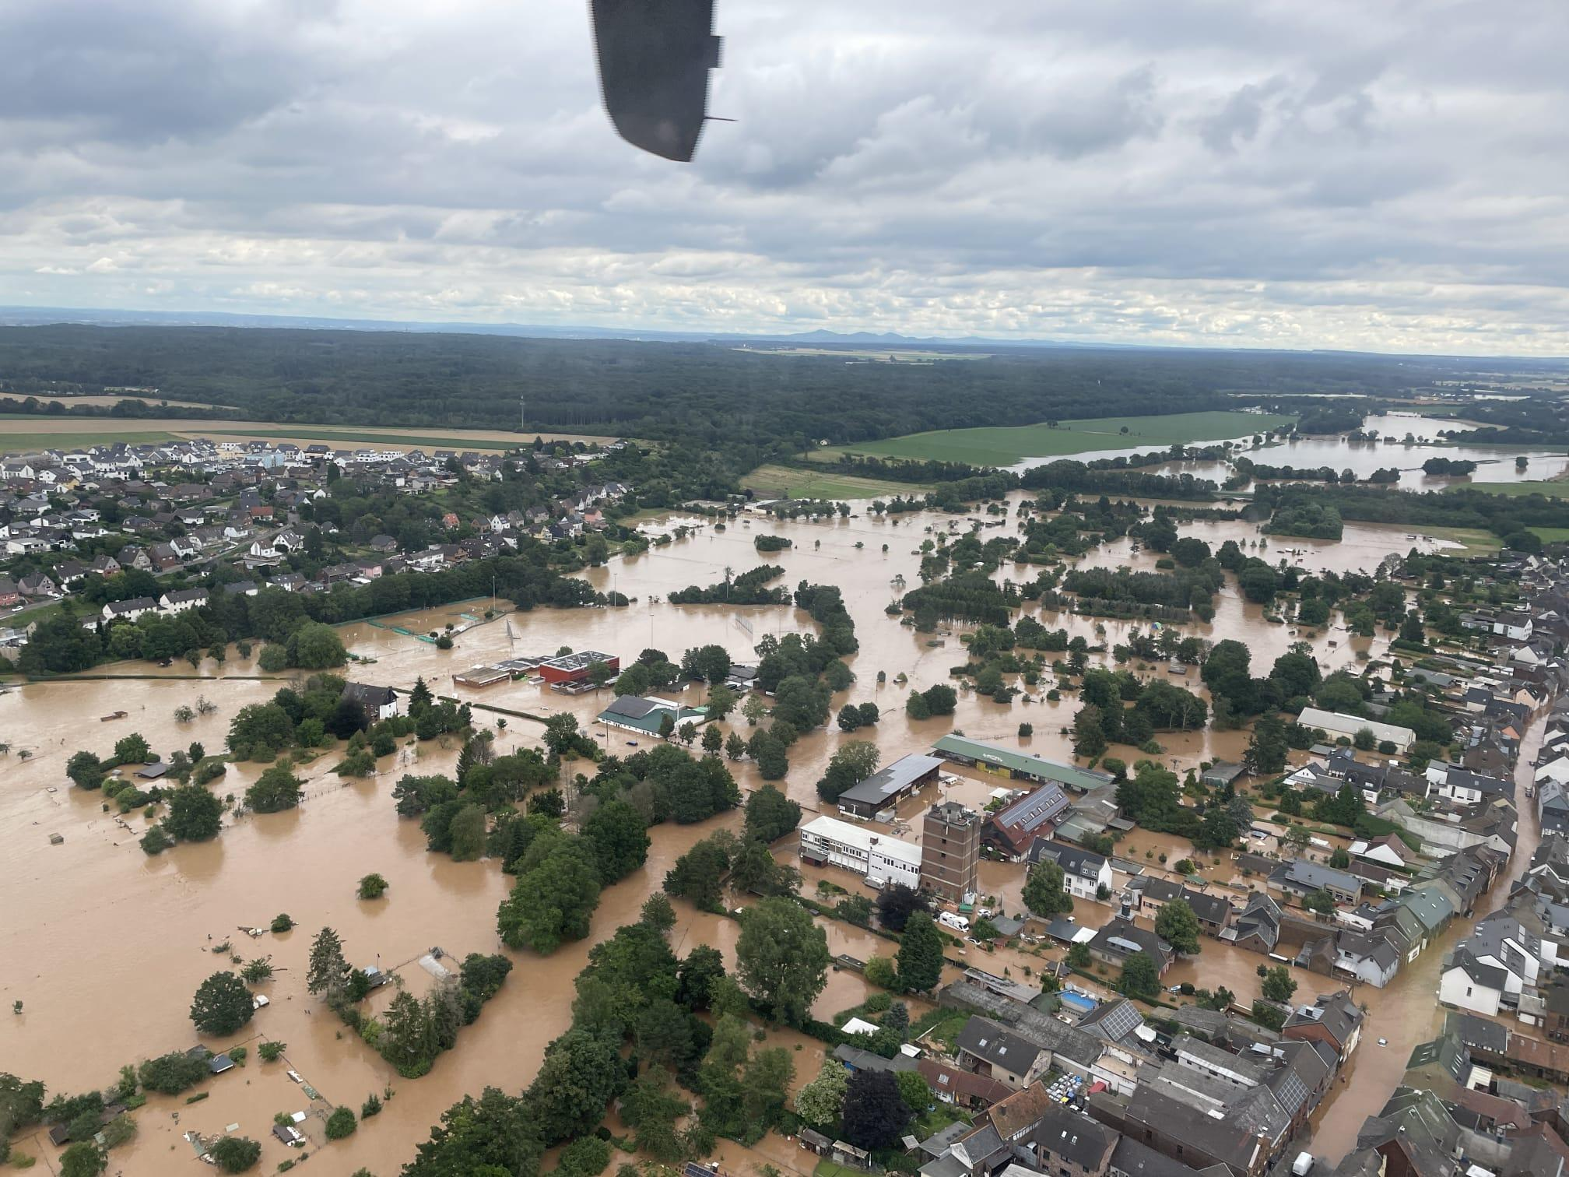
Direct Correlation
Side by side view of sea ice and rising sea level
Notes:
By viewing the data together it is apparent that there is a direct correlation between ice melting and the sea rising.

Slide 5
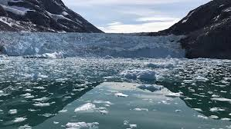
Results
Notes:
Using regression models we have found that by [insert year] we will have lost all of our sea ice.

Slide 6
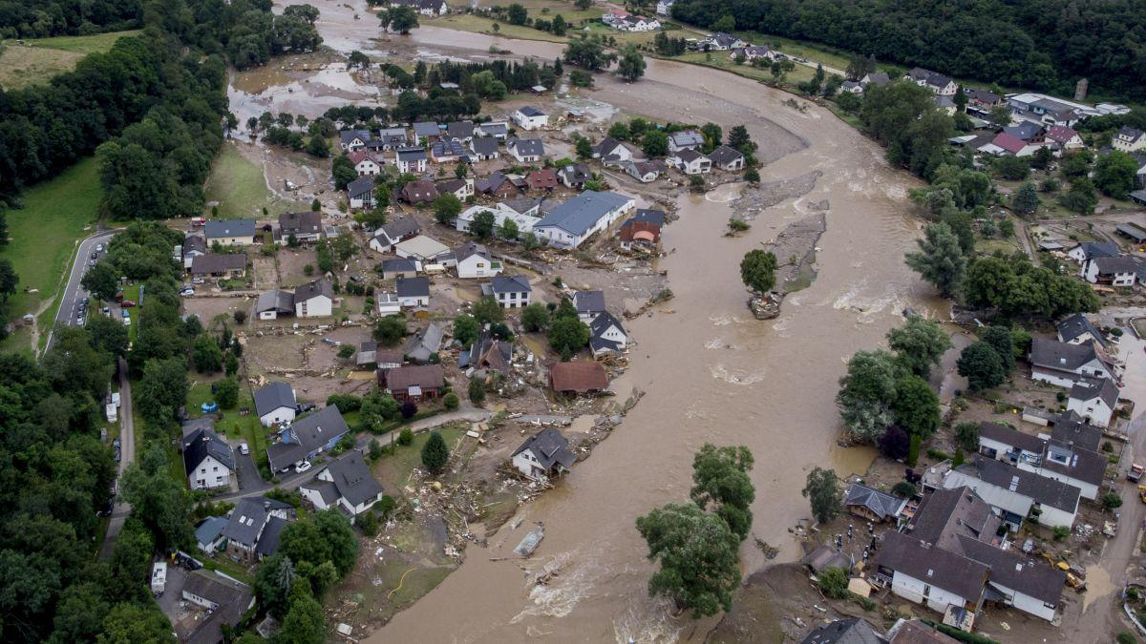
Sea levels in [year]
Sea level projection
Notes:
By [year] the sea levels will have reached a record height of [insert height if we have it]. This will result in many large cities being partially under water.

Slide 7
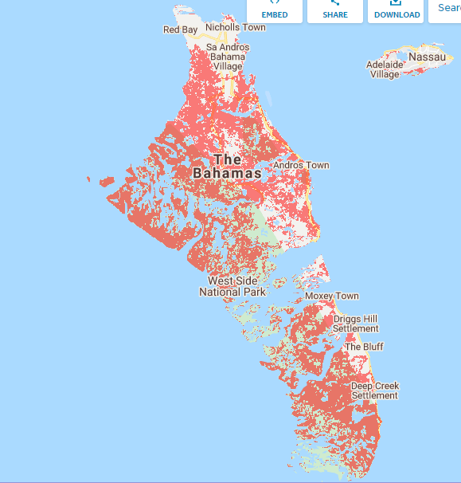
The Bahamas
Notes:
The Bahamas will be completely devastated. Nearly all of its land mass will be underwater.

Slide 8
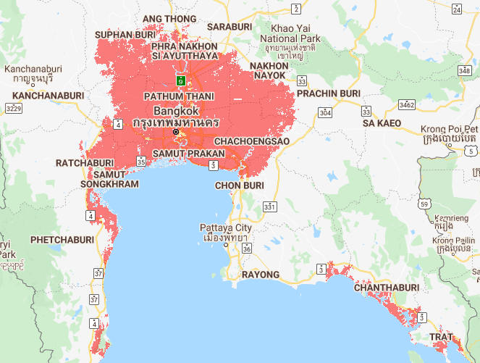
Bangkok
Notes:
The vast majority of Bangkok and the surrounding towns will be completely flooded.

Slide 9
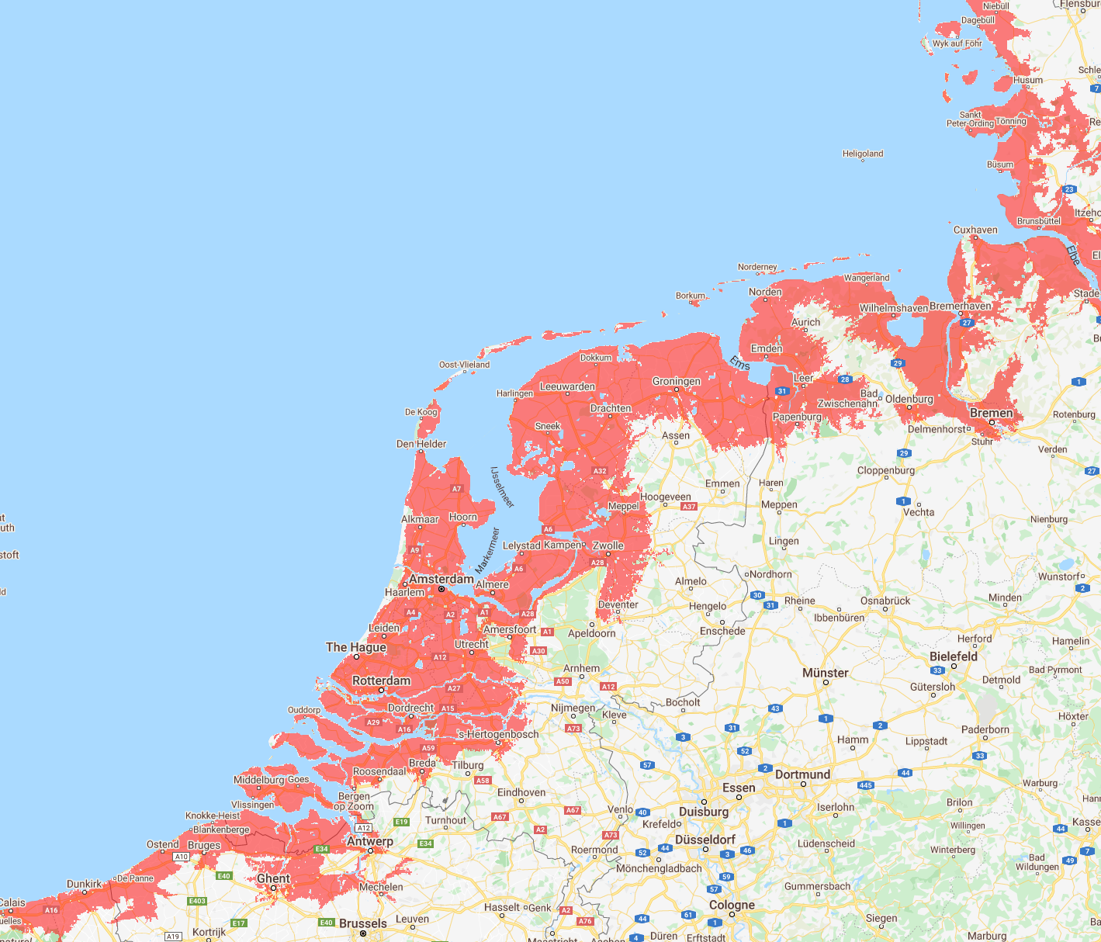
The Netherlands
Notes:
The Netherlands will lose huge amounts of coastline from top to bottom.

Slide 10
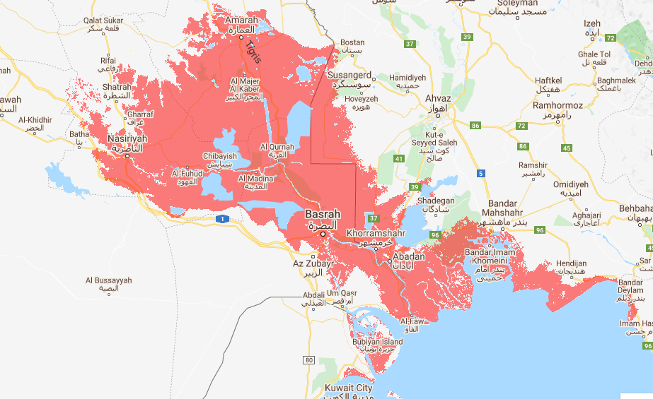
Iraq
Notes:
Iraq will lose an incredible amount of landmass completely flooding over a dozen towns.

Slide 11
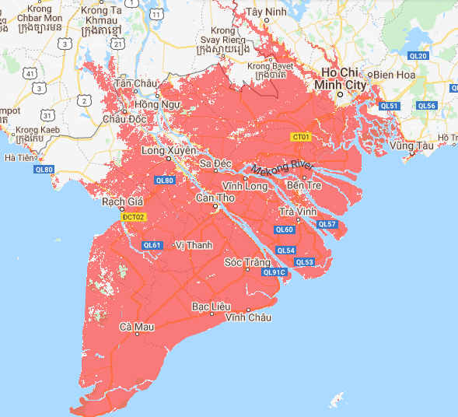
Vietnam
Notes:
Vietnam will lose it’s entire southern tip.

Slide 12
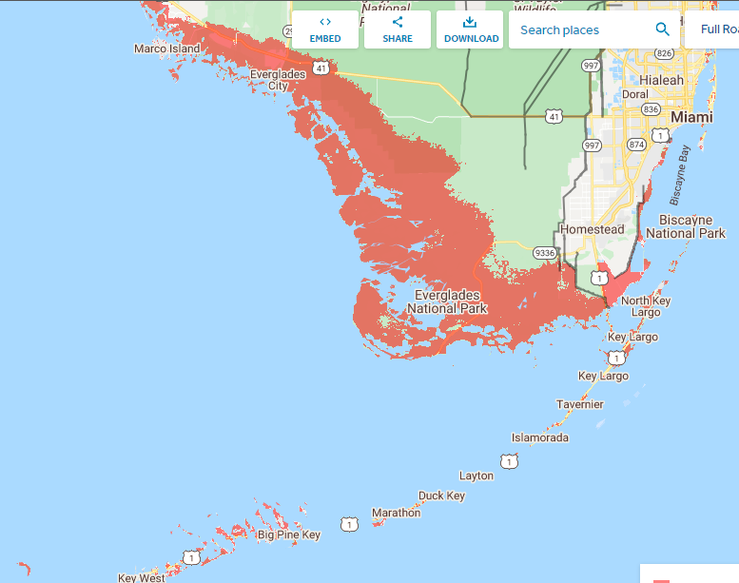
Miami
Notes:
The US will be hit as well. Miami will lose much of the keys and southern coast.

Slide 13
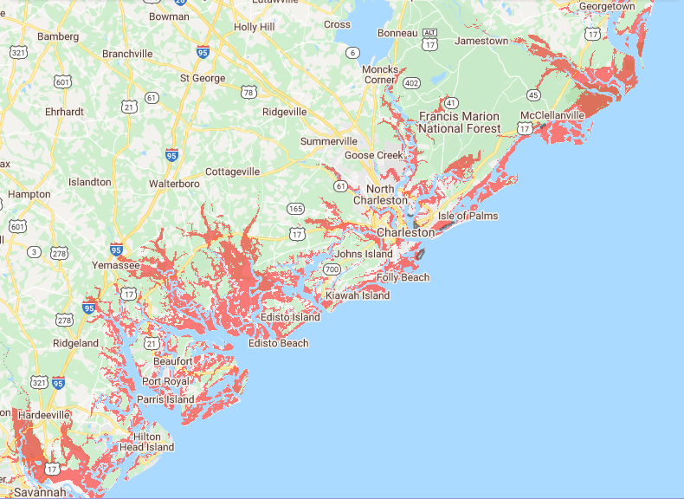
South Carolina
Notes:
South Carolina will lose landmass along its coast and riverways.

Slide 14
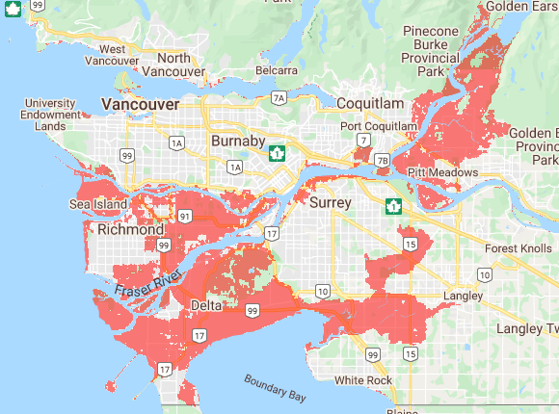
Vancouver
Notes:
As you can see from this map, much of the land being flooded in vancouver is in dense urban areas.

Slide 15
World Impact
Set world map as background

Slide 16
World impact continued
More world impact if it is able to be updated by year or area

Slide 17
Summary

